Slide 1

Semantic Search + RAG Application
(Bedrock + OpenSearch)
* Serverless AI-powered document intelligence system
@TechWithNu

Slide 2
Semantic Search + RAG Application
(Bedrock + OpenSearch)
* Serverless AI-powered document intelligence system
@TechWithNu

Slide 3
Table of Contents
🧩 1. What is Semantic Search?
🧠 2. What is RAG (Retrieval-Augmented Generation)?
🚀 3. What We Will Build
⚙️ 4. Workflow in Action
💻 5. Set up the App

Slide 4
🧩 1. What is Semantic Search?
🔍 Input query
⬇️
🧠 Encode to vector
⬇️
📊 Compare similarity with data vectors
⬇️
🎯 Return the most semantically relevant results
🔍

Slide 5
🧠 2. What is RAG?
💬 Input query
⬇
📚 Retrieve relevant information
⬇
🧠 Feed into language model (LLM)
⬇️
✨ Generate answer based on data and context
🤖

Slide 6
🧠 Semantic Search = The “thinking brain” of RAG 🧩
→ 🔍 Finds meaning
→ 📚 Retrieves facts
→ 💡 Enables accurate answers

Slide 7
🚀 3. What We Will Build
💾
Ingest Flow
💬
Query Flow

Slide 8
🚀 3. What We Will Build
📤 Upload Documents
⬇️
🧩 Chunk (split content into smaller parts)
⬇️
🧠 Embedding (convert chunks → vectors)
⬇️
🔍 Index into OpenSearch (store vector data for retrieval)
📤
Ingest Flow

Slide 9
🚀 3. What We Will Build
👤 User enters query
⬇️
🧠 Semantic Search (convert query → vector, find similar content)
⬇️
📚 Retrieve context (get most relevant chunks)
⬇️
🤖 Call Bedrock model (generate answer using context)
⬇️
💡 Response (deliver meaningful answer to user)
💬
Query Flow

Slide 10
⚙️ 4. Workflow in Action
📥 Step 1: Ingest Documents
⚙️ Stage 1: Document Processing Pipeline
📤 Upload →
📄 Extract Text →
🧩 Chunk →
🧠 Generate Embedding (via Bedrock Embedding Model) →
🗄️ Store to OpenSearch
🌐 Stage 2: API Integration
🚪 API Gateway →
📤 Upload Documents →
☁️ Trigger Ingestion Pipeline

Slide 11
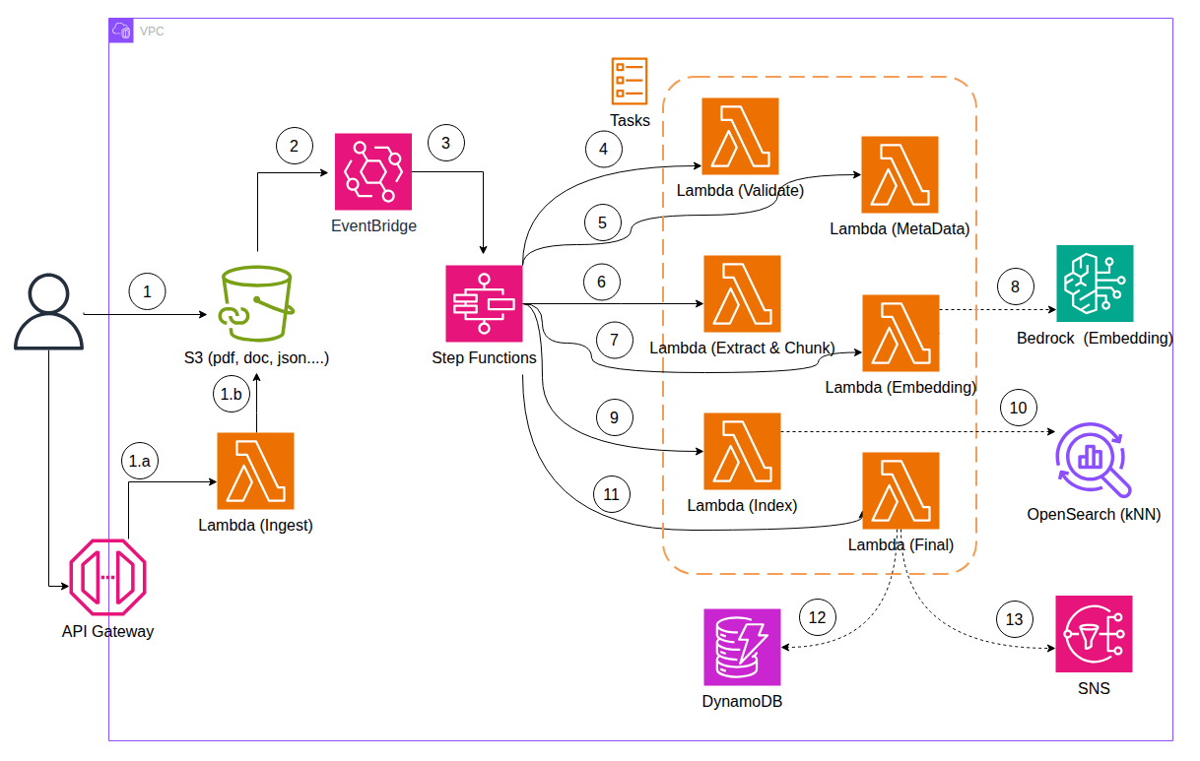

Slide 12
⚙️ 4. Workflow in Action
🔍 Step 2: Query + RAG
⚙️ Stage 1: Semantic Search Pipeline
🧑‍💻 User Query →
🧠 Generate Embedding →
🔎 Search in OpenSearch
🤖 Stage 2: Retrieval-Augmented Generation (RAG)
📚 Retrieve Top-K Contexts →
🚀 Send to Bedrock LLM →
💬 Generate Augmented Answer

Slide 13
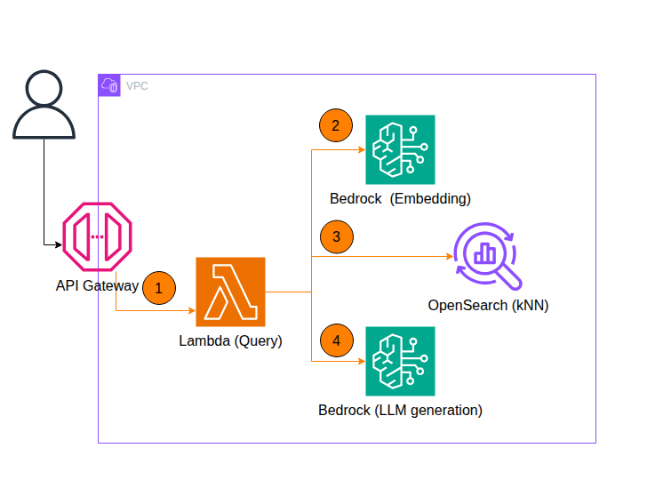

Slide 14
System Diagram
☁️
🧩

Slide 15
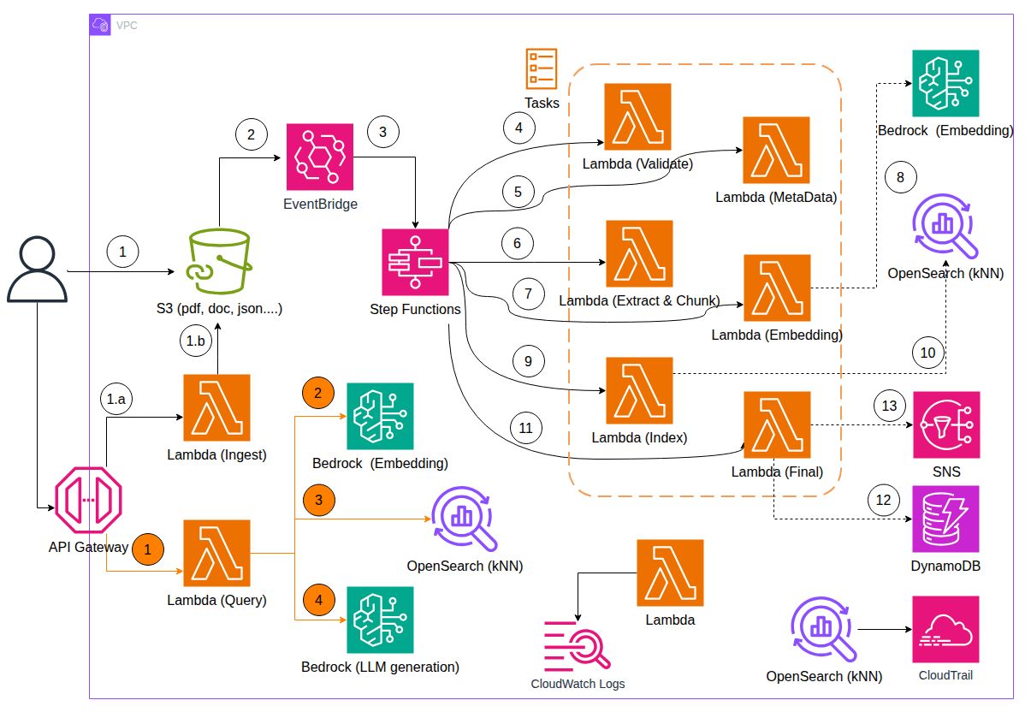

Slide 16
Main Services
🧩 Service ⚙️ Role
1.☁️ Amazon S3 Document Source
2.🔁 AWS Step Functions Workflow Orchestration
3.🧩 AWS Lambda Processing Logic
4.🧠 Amazon Bedrock (Embedding) Generate Embeddings
5.🤖 Amazon Bedrock (LLM) Generate Responses
6.🔎 Amazon OpenSearch Store & Retrieve Embeddings
7.💾 Amazon DynamoDB Metadata Store
8.📢 Amazon SNS Notification & Trigger
9.🌐 Amazon API Gateway Entry Point
10. ⏰ Amazon Event Bridge Event Routing & Automation

Slide 17









💻 5. Set up the App

Slide 18
OpenSearch (kNN)
🧩 Task ⚙️ Configuration/Setup
1️⃣ Create an Service domain semantic-search
2️⃣ Choose the Right Version & Region `OpenSearch 2.11` or newer (supports native kNN vector search).
3️⃣ Instance t3.small.search
4️⃣ Count 1
5️⃣ EBS 10 GB gp3
6️⃣ kNN Enabled
7️⃣ AZ 1

Slide 19
S3 (Simple Storage Service)
🧩 Task ⚙️ Configuration / Action
🪣 1️⃣ Create S3 Bucket bucket-name = semantic-doc-source
🔔 2️⃣ Add Event Notification Send event to ⏰ EventBridge / 🔁 Step Functions
🔐 3️⃣ Configure IAM Policy s3:GetObject, s3:ListBucket
📁 4️⃣ Create Folder Structure (optional) documents/raw/, documents/processed/
♻️ 5️⃣ Enable Versioning (optional) Enable “Bucket Versioning”
🔒 6️⃣ Enable Server-side SSE-S3 or SSE-KMS
⏳ 7️⃣ Configure Lifecycle Rule (optional) Save storage costs

Slide 20
Bedrock (Embedding)
🧩 Task ⚙️ Configuration / Action
🧠 1️⃣ Select Embedding Model Example: amazon.titan-embed-text-v1 or cohere.embed-english-v3
📖 2️⃣ Receive Text Chunks from Lambda Text chunks ~500–1000 tokens
⚙️ 3️⃣ Generate Embeddings Use Bedrock API InvokeModel
📦 4️⃣ Store Embeddings into OpenSearch Include vector + metadata
🔍 5️⃣ Validate Embedding Quality (optional) Use cosine similarity or test queries
🔁 6️⃣ Re-generate Embeddings (optional) Triggered by new S3 upload event
🔐 7️⃣ Secure Access to Bedrock IAM Role: bedrock:InvokeModel

Slide 21
Bedrock (LLM)
🧩 Task ⚙️ Configuration / Setup
1️⃣ Choose LLM Model Example: modelId = "anthropic.claude-3-sonnet"
2️⃣ Construct Prompt Template Example: "Use the following context to answer user’s question: {context} Question: {query}"
3️⃣ Set Generation Parameters maxTokens, temperature, topP, stopSequences
4️⃣ Call Bedrock API Using AWS SDK for Python, PHP, or Node.js
5️⃣ Parse and Return Response Clean markdown / JSON formatting for UI
6️⃣ (Optional) Logging & Monitoring Use CloudWatch Logs & Bedrock metrics
7️⃣ (Optional) Safety Filter Bedrock built-in content filter or post-validation step

Slide 22
DynamoDB (Metadata Store)
🧩 Task ⚙️ Configuration / Setup
1️⃣ Create DynamoDB Table TableName = semantic-doc-metadata
2️⃣ Define Primary Key PK = document_id, SK = chunk_id or type#id pattern
3️⃣ Store Document Metadata Attributes: filename, upload_date, embedding_status, owner, version
4️⃣ Store Chunk Metadata chunk_id, chunk_text, embedding_vector_ref, opensearch_index_id
5️⃣ Store Query Logs (optional) query_id, query_text, response_text, timestamp
6️⃣ Setup IAM Policy dynamodb:PutItem, dynamodb:GetItem, dynamodb:Query
7️⃣ Enable TTL (optional) ttl_attribute = expire_at
8️⃣ Add GSI/LSI (optional) Example: GSI on filename, owner, or status

Slide 23
SNS (Simple Notification Service)
🧩 Task ⚙️ Configuration / Setup
1️⃣ Create SNS Topic Example: semantic-doc-events
2️⃣ Define Subscriptions Email, Lambda, EventBridge, or HTTPS endpoint
3️⃣ Configure Publisher Policy IAM Policy → sns:Publish
4️⃣ Publish Message After Processing Include payload: document_id, status, timestamp
5️⃣ Handle Subscribed Actions Email alert / Lambda update / Log to DynamoDB
6️⃣ (Optional) Enable Delivery Status Logs CloudWatch Logs integration
7️⃣ (Optional) Message Filtering Example: eventType = "SUCCESS" or "ERROR"

Slide 24
Lambda Functions
Function Name Description
1️⃣ ValidateS3Event Validate and parse S3 event notification before processing.
2️⃣ GetObjectMetadata Retrieve metadata (e.g., filename, size, content type) from the uploaded S3 object.
3️⃣ ExtractAndChunk Extract text from documents and split into smaller chunks for embedding.
4️⃣ GenerateEmbedding Use "Amazon Bedrock Embedding Model" to convert text chunks into vector embeddings.
5️⃣ IndexChunkToOpenSearch Index generated embeddings and metadata into "OpenSearch (kNN index)".
6️⃣ FinalIngest Mark successful ingestion process and update tracking metadata (e.g., DynamoDB).
7️⃣ FinalizeNoChunk Handle small or unsupported documents without chunking.
8️⃣ UploadToS3 Upload processed or transformed files back to S3 (e.g., embeddings, logs).
9️⃣ Query Retrieve similar content by performing "semantic search" through OpenSearch + Bedrock.

Slide 25
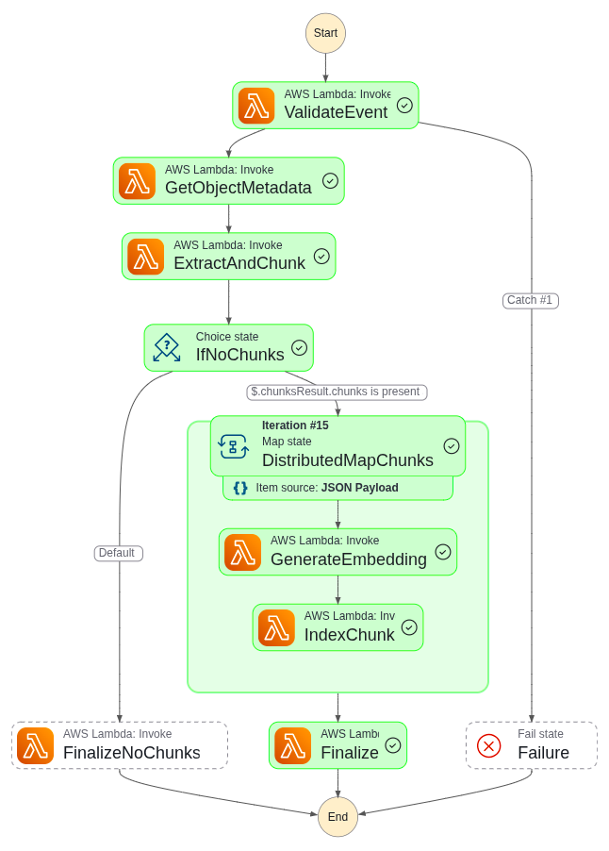
Step Functions

Slide 26
Event Bridge
Task Detail/Action
1.🧭 Open EventBridge Console Go to Amazon EventBridge
→ select Event buses
→ choose default (or create a new Event Bus)
2.🪄 Create a New Rule → Name: `S3UploadTriggerStepFunction`
→ Description: Trigger Step Function when a document is uploaded to S3
3.🧩 Define Event Source Choose AWS events or Event pattern → select Pre-defined pattern by service
4.🪣 Select Service and Event Type - Service provider: AWS
- Service name: S3
- Event type: Object Created (All)
5.🎯 Add Event Filters (Optional) Add filters for precision: Bucket: semantic-rag-documents
Prefix: input/
Suffix: .pdf

Slide 27
Event Bridge
Task Detail/Action
6.🔗 Choose Target Target type: AWS Service
Service: Step Functions
State machine: SemanticRAG-IngestWorkflow
7.🧱 Configure Input to Step Function Under Configure input, choose Matched event (or provide a custom JSON template to include metadata like bucket name, file key, and timestamp)
8.🛡️ Configure Permissions Choose Create a new role for this specific resource, or assign an IAM Role with permission: {
"Effect": "Allow",
"Action": "states:StartExecution",
"Resource": "arn:aws:states:REGION:ACCOUNT_ID:stateMachine:SemanticRAG-IngestWorkflow"
}`

Slide 28
Event Bridge
Task Detail/Action
9.📦 (Optional) Add Dead-Letter Queue (DLQ) In Additional settings, specify an SQS or SNS DLQ to capture failed event deliveries
10.✅ Review and Create Rule Review configuration:
Source (S3), Event Pattern, Target (Step Function),
Permissions → click Create rule
11.🔍 Verify Rule Activation Confirm that the rule status = Enabled
12.🧪 Test Integration Upload a test file to S3
→ check EventBridge Monitoring tab and Step Functions Executions

Slide 29
API Gateway
🔢 API 📘 Purpose
☁️ API #1: /upload Upload document for Ingest Pipeline
🧍User → 🌐 API Gateway → 🪣 S3 Bucket → ⚙️ EventBridge → 🧠 Step Functions → 🧩 Bedrock (Embedding) → 🔍 OpenSearch Indexing
S3, EventBridge, Step Functions, Bedrock Embedding, OpenSearch
This API receives file (PDF, DOCX, TXT, etc.) from the client. The file is stored in S3. Then an event triggers Step Functions via EventBridge to start the ingestion process (chunk → embedding → index).
🔍 API #2: /query Query document for Semantic Search (RAG)
🧍User → 🌐 API Gateway → 🧠 Lambda (Query Handler) → 🔍 OpenSearch (kNN) → 🤖 Bedrock (LLM) → 🗨️ Response
Lambda, OpenSearch, Bedrock LLM
This API handles user queries. It retrieves top-k relevant chunks from OpenSearch via kNN search, sends context + query to Bedrock LLM, and returns the final generated answer to the client.

Slide 30
Conclusion

Slide 32
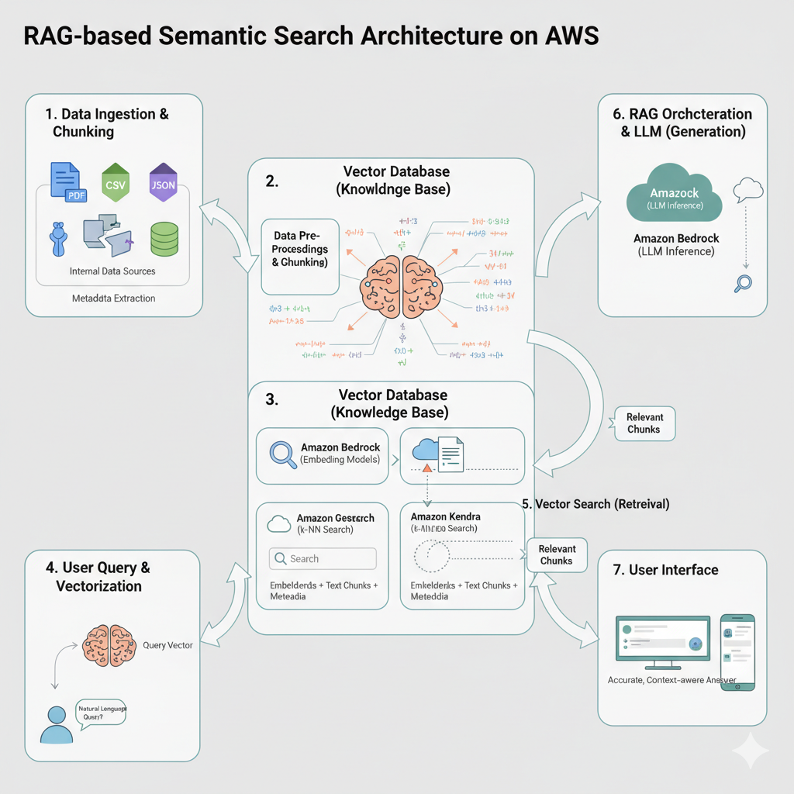

Slide 33
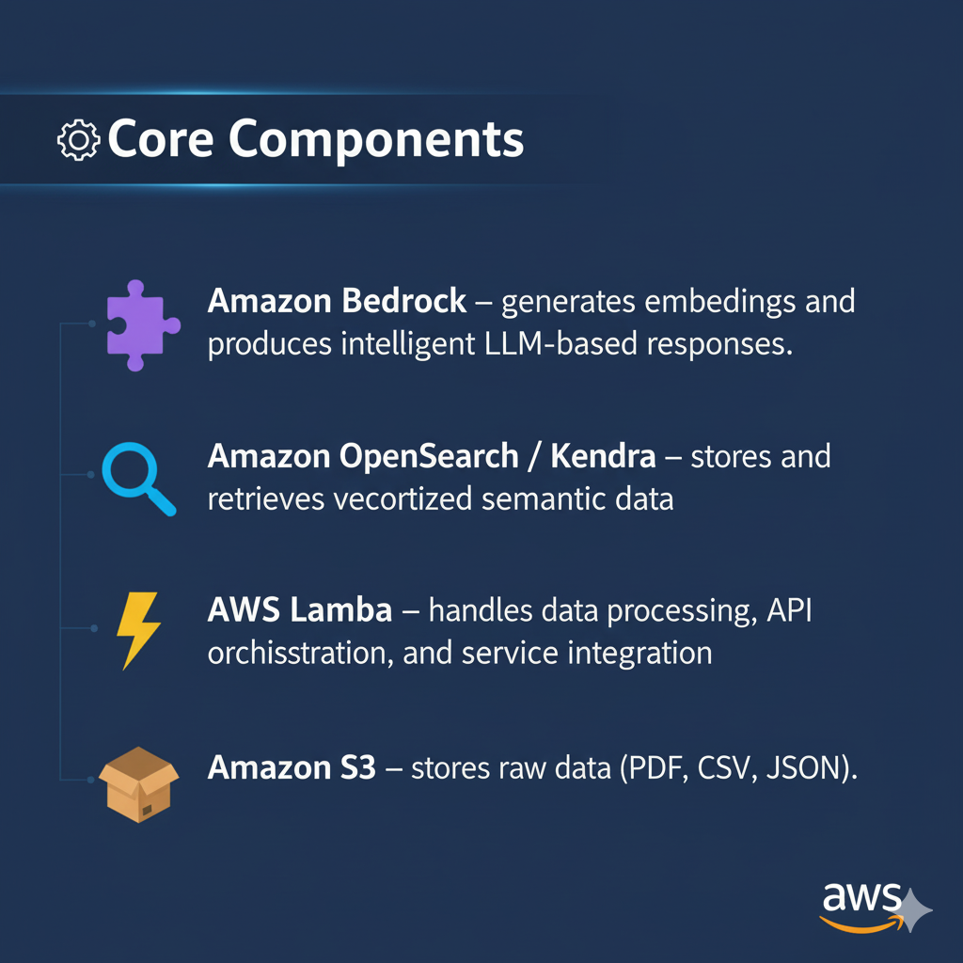

Slide 34
System Architecture
Diagram:
User (Web UI / API) ↓API Gateway ↓Lambda (Query Handler) ↔ OpenSearch / Kendra (Vector Retrieval) ↓Amazon Bedrock (RAG) ↓Response → User
Background pipeline:S3 → Lambda → Textract → Chunk → Embed → Index

Slide 35
AWS Services Used
| Service | Purpose || --------------------- | -------------------------------- |
| **S3** | Store source and processed files |
| **Lambda** | Ingest, embed, query |
| **Bedrock** | Embeddings + LLM generation |
| **OpenSearch/Kendra** | Semantic retrieval |
| **API Gateway** | Expose endpoints |
| **CloudWatch** | Logs and metrics |

Slide 36
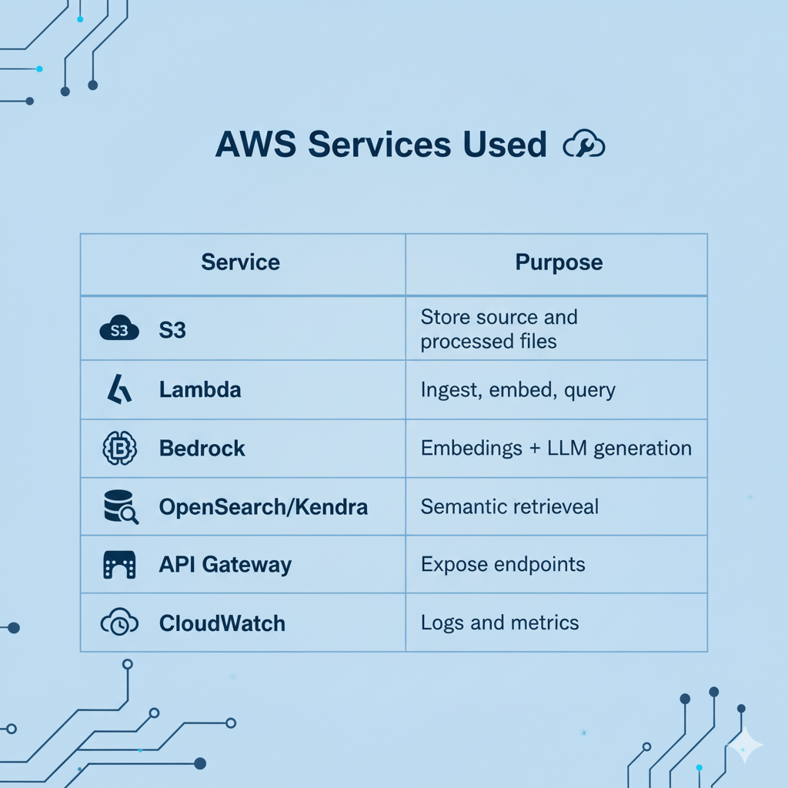

Slide 37
Data Ingestion Flow
1. **Upload documents** → S32.
**Extract text:** Textract / parser3.
**Clean & normalize text**4.
**Chunking:** ~800 tokens, 20–30% overlap5.
**Generate embeddings** (Bedrock)6.
**Index into OpenSearch/Kendra**
🎯 Kết quả: mỗi chunk có vector + metadata → phục vụ truy vấn.

Slide 38
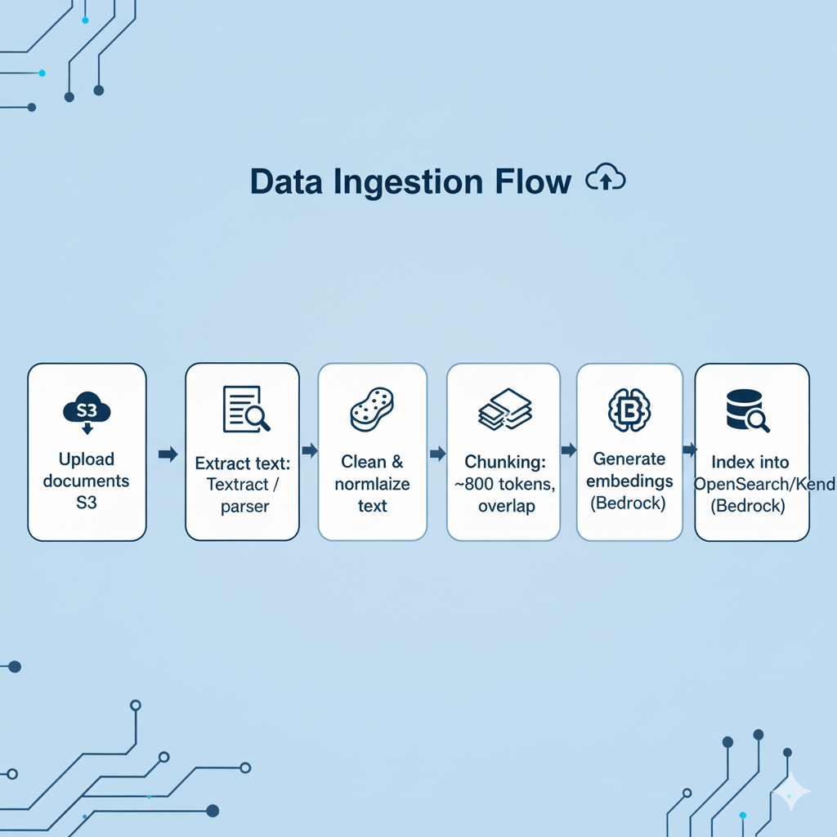

Slide 39
Query Flow (RAG)
1. User enters query
2. Lambda embeds query
3. Retrieve top-K chunks
4. Compose RAG prompt
5. Call Bedrock → generate answer
6. Return answer + source refs

Slide 40
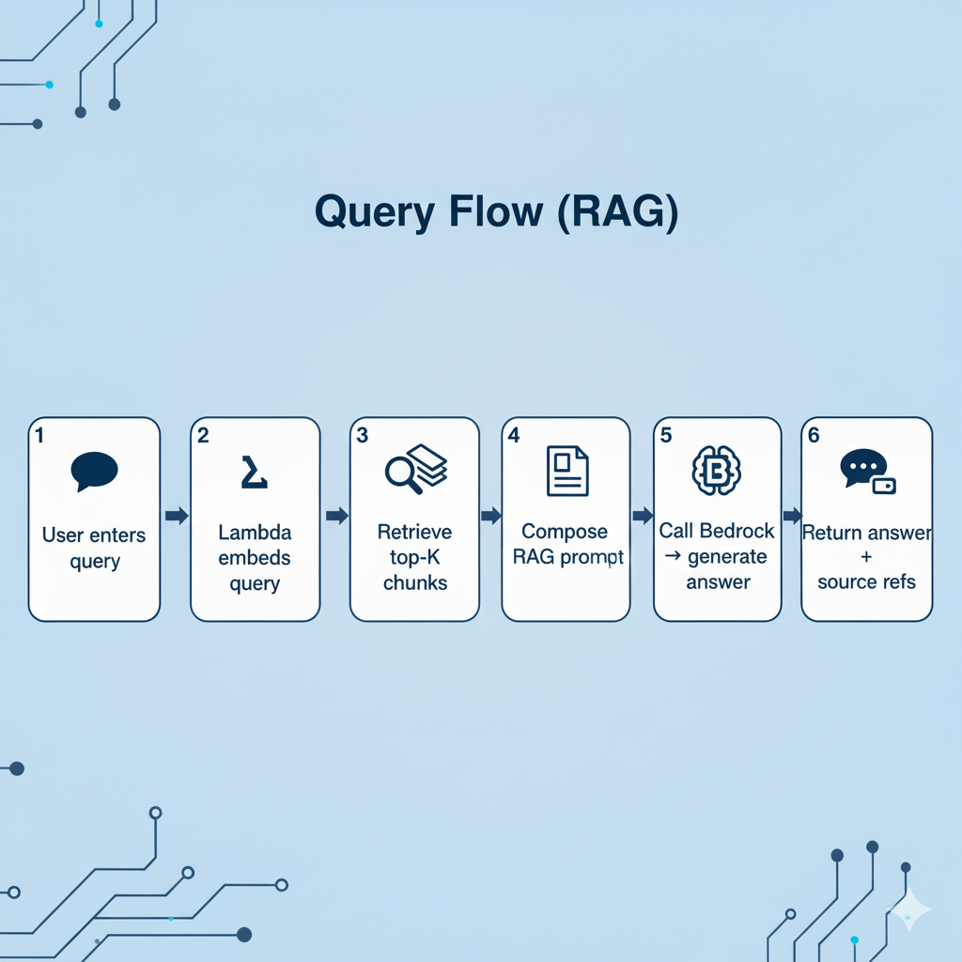

Slide 41
Example Prompt
```System: Answer using only the provided excerpts.Context:[1] "Payment terms…"
[2] "Warranty: 12 months…"
User: "What is the warranty period?"```
**Output:**“Product A has a 12-month warranty [2].”

Slide 42
Key Design Choices
* Use **Bedrock embeddings** for semantic meaning*
**OpenSearch k-NN** for fast vector similarity*
**Chunk overlap** to maintain context*
Keep all services **serverless***
Metadata filtering for access control
(Bỏ toàn bộ phần “re-ranking”, “cosine threshold”, “reranker model”, vì không cần ở mức slide.)

Slide 43
Security & IAM
* **S3:** read/write documents*
**Bedrock:** `InvokeModel`*
**OpenSearch/Kendra:** query/index access*
**CloudWatch:** log + metrics
💡 *All data encrypted at rest (S3, OpenSearch).*

Slide 44
Deployment & CI/CD
* Deploy infra with **Terraform / SAM**
* Components: S3, Lambda, IAM, OpenSearch, API Gateway
* Optional Step Functions for ingestion orchestration
* CI/CD: CodePipeline / GitHub Actions

Slide 45
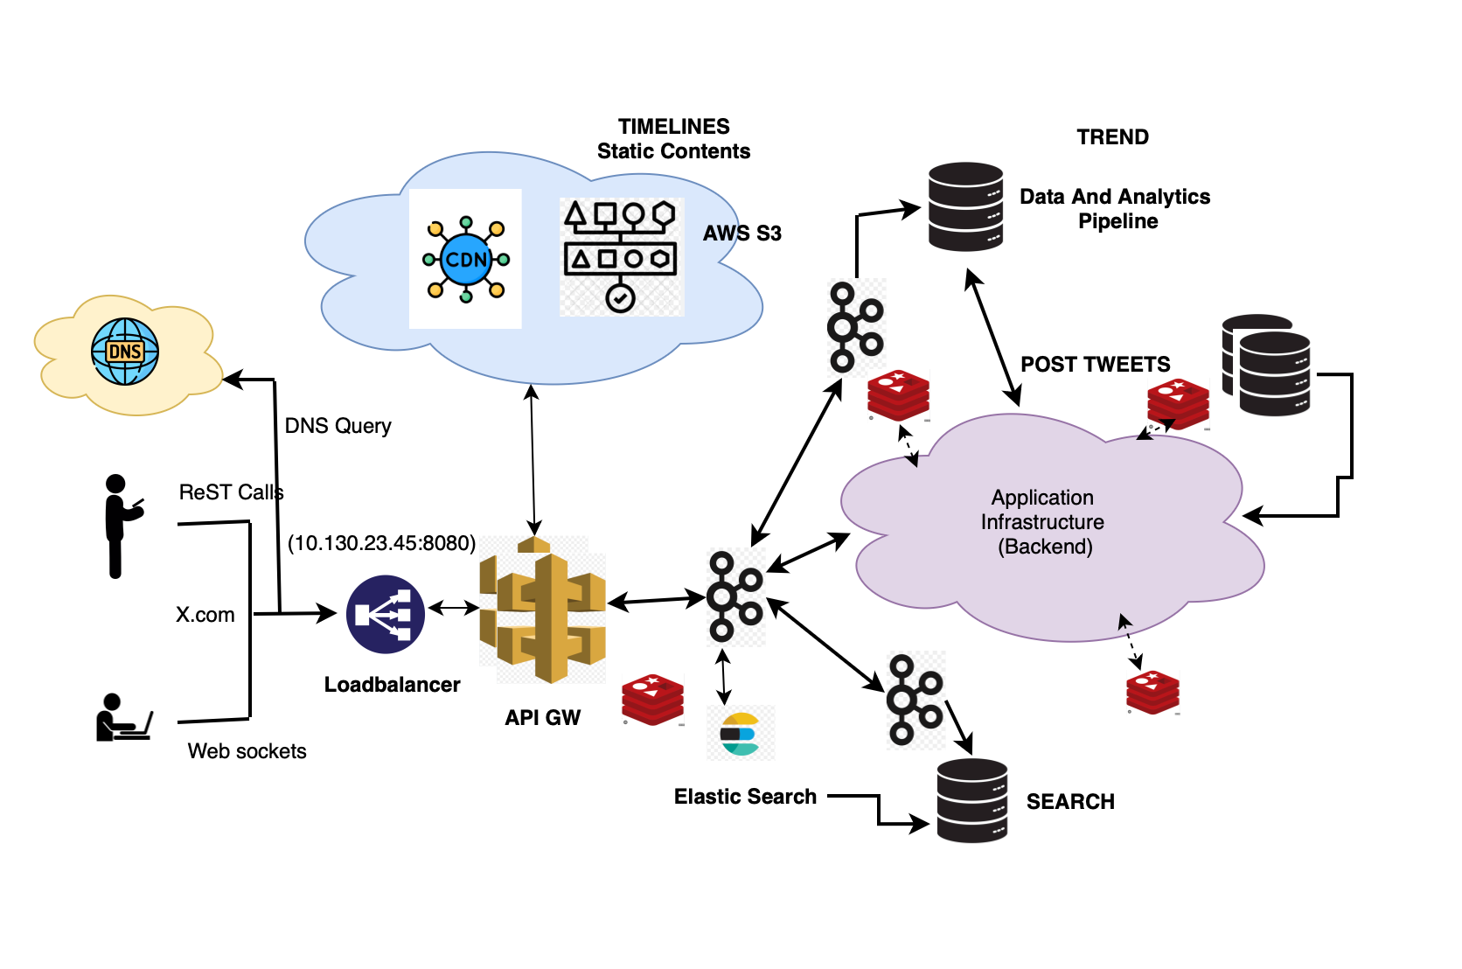

Slide 46
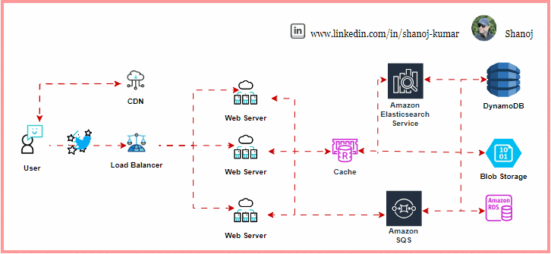

Slide 47
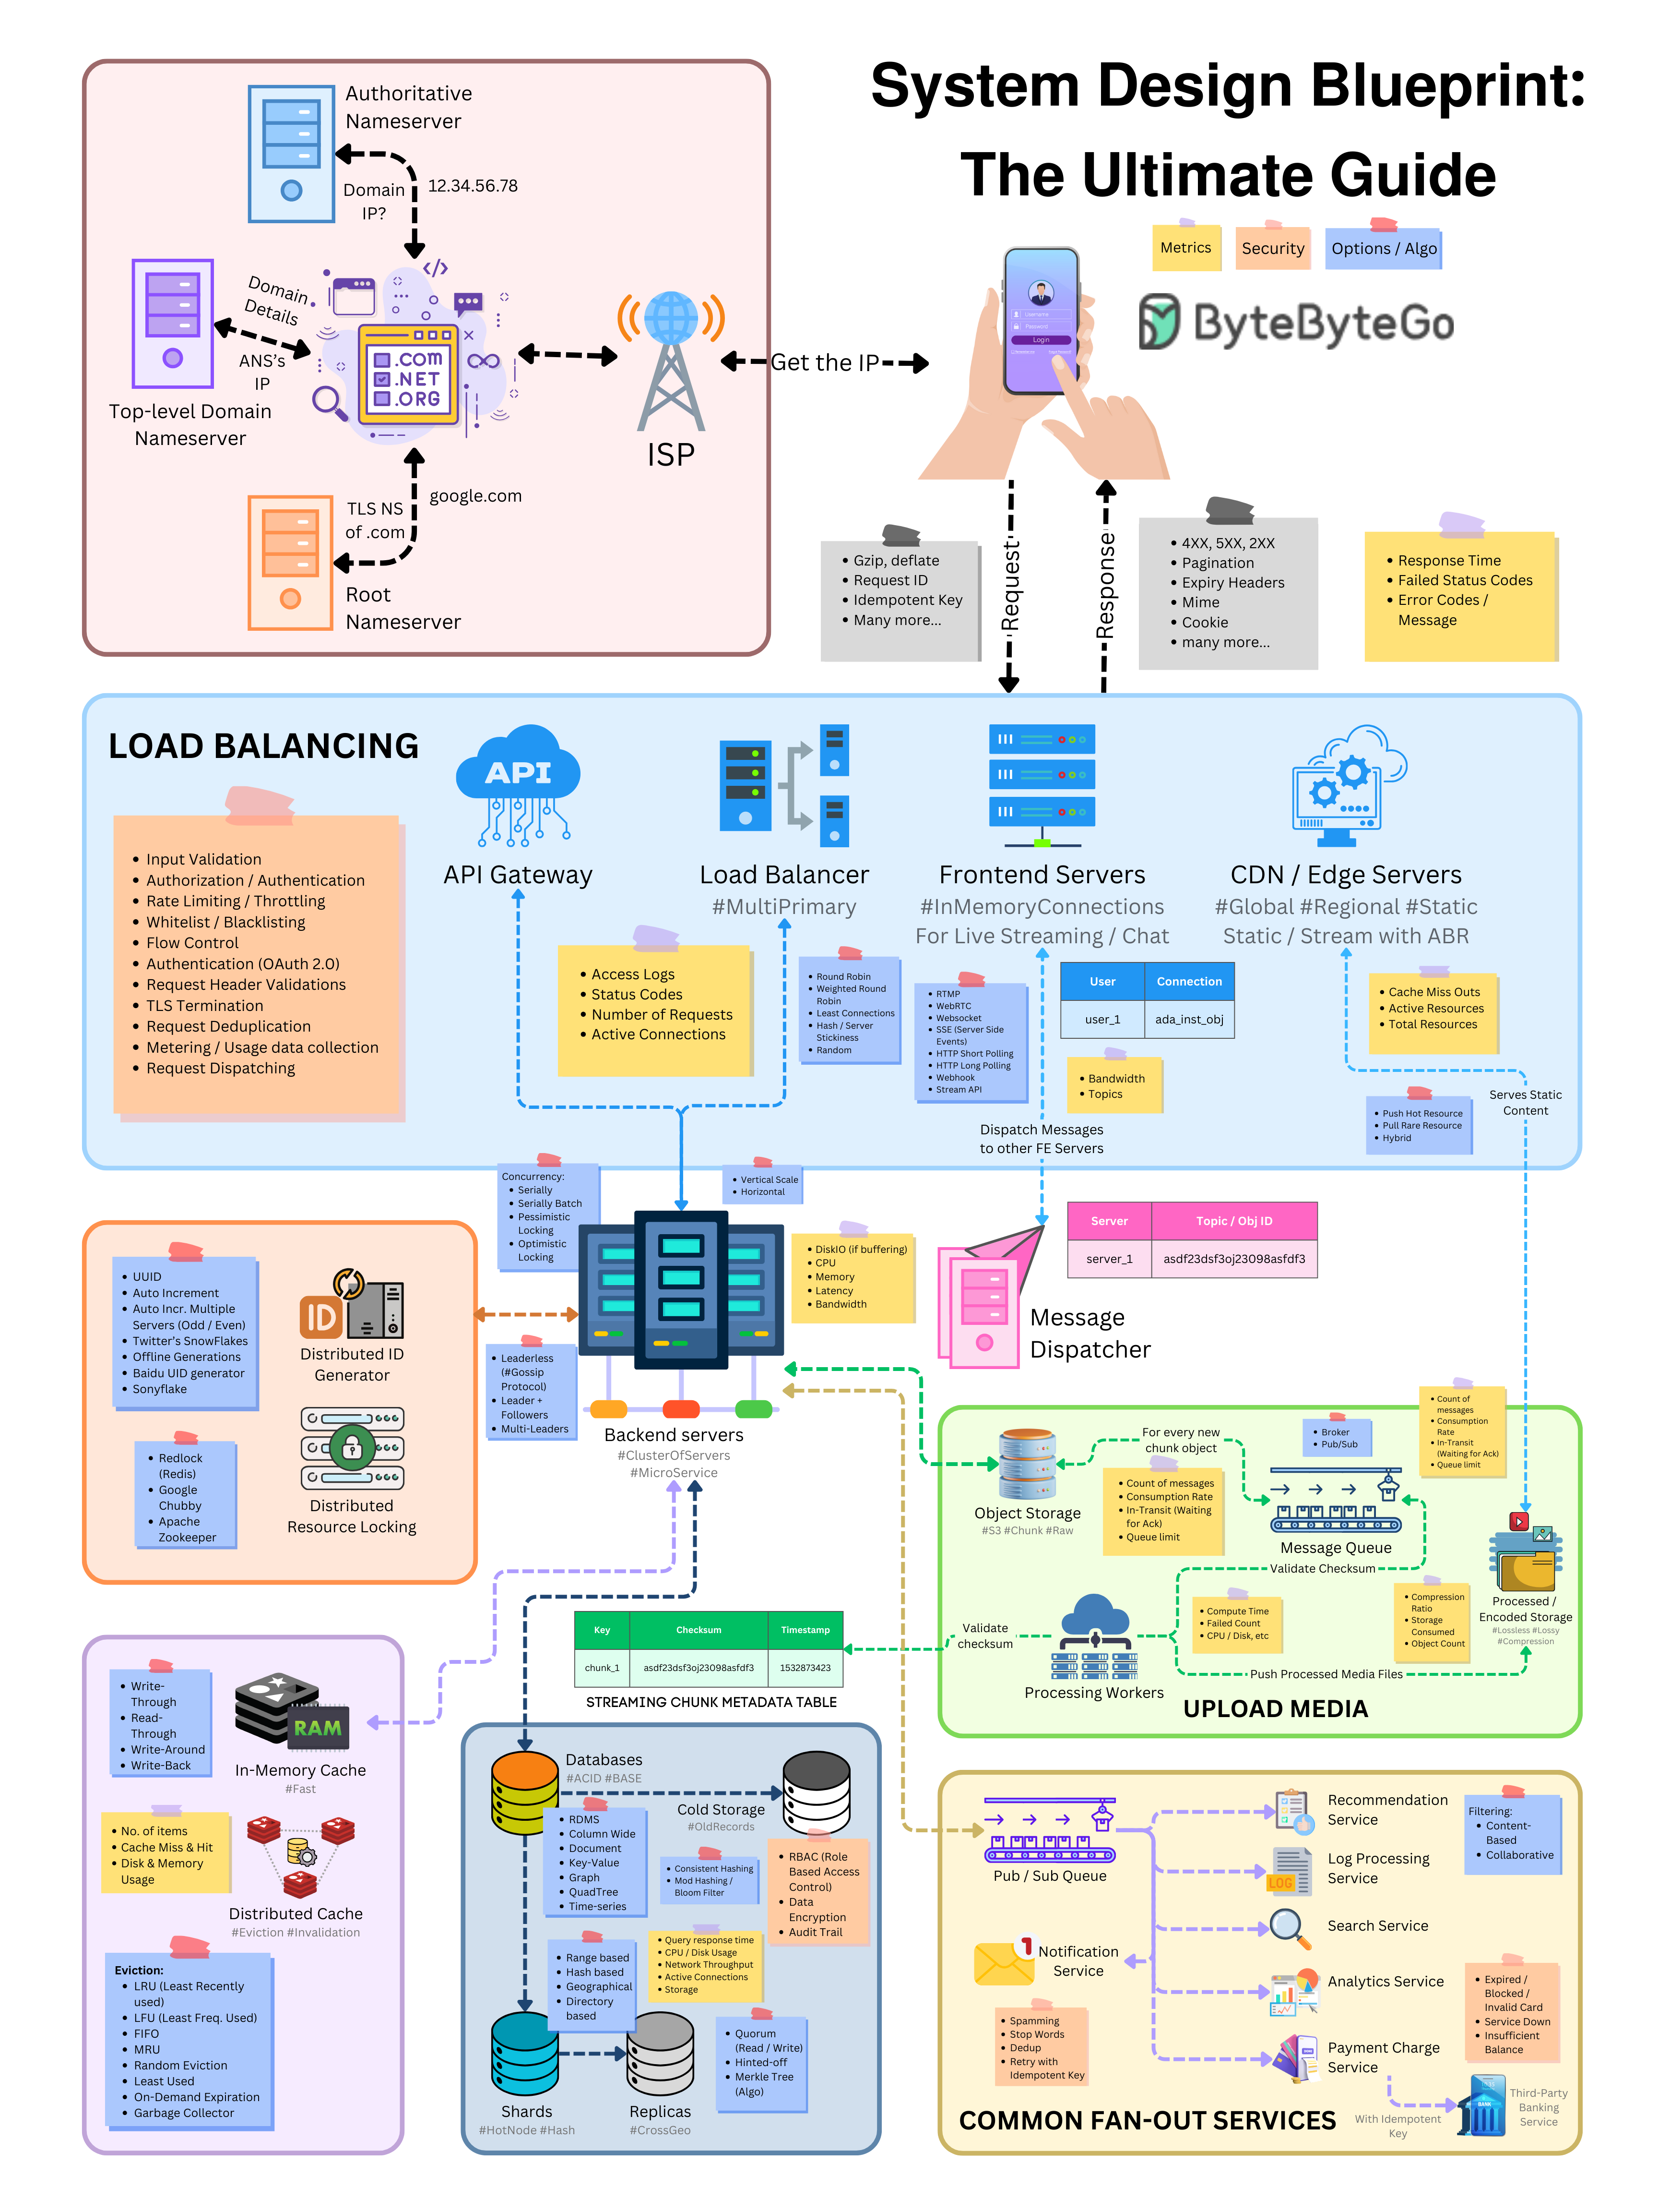

Slide 48
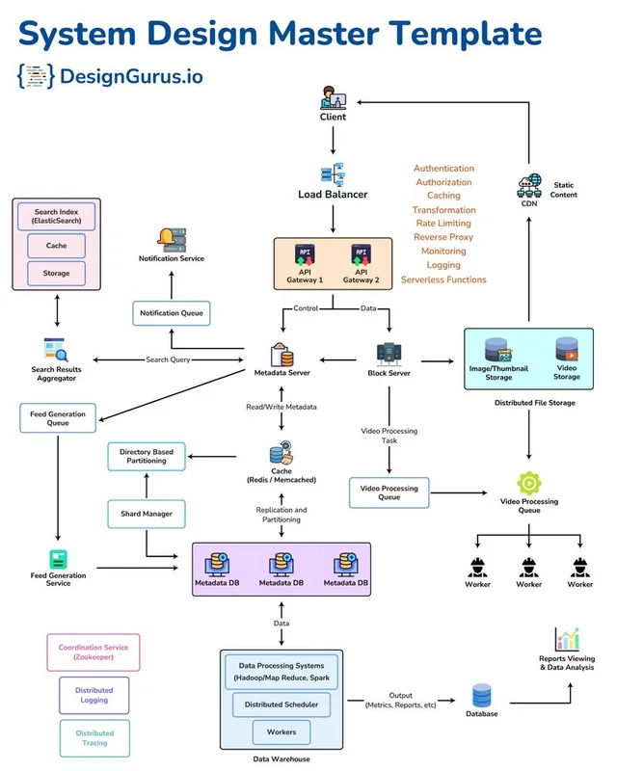

Slide 49
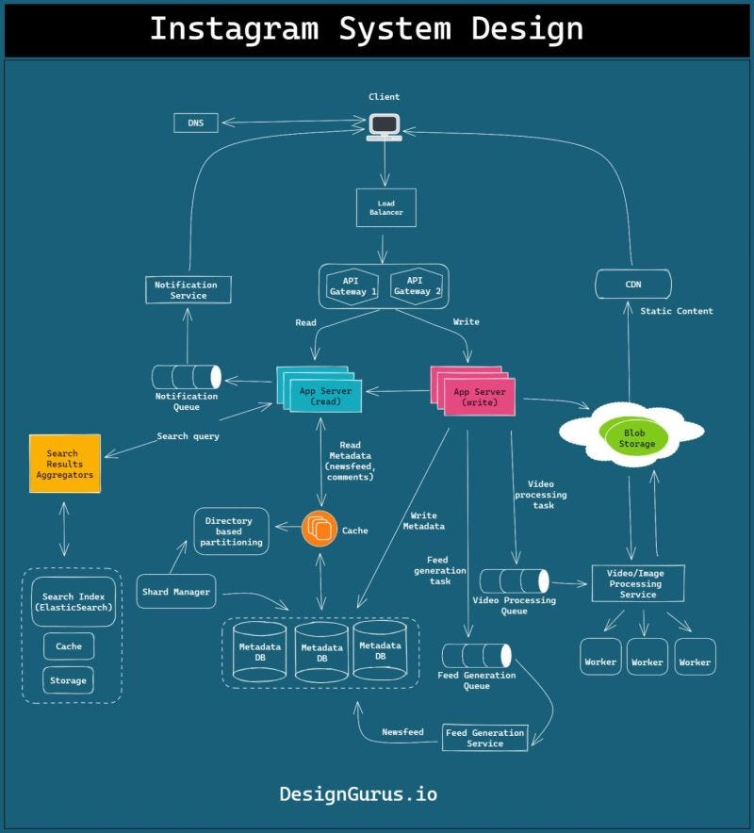

Slide 50
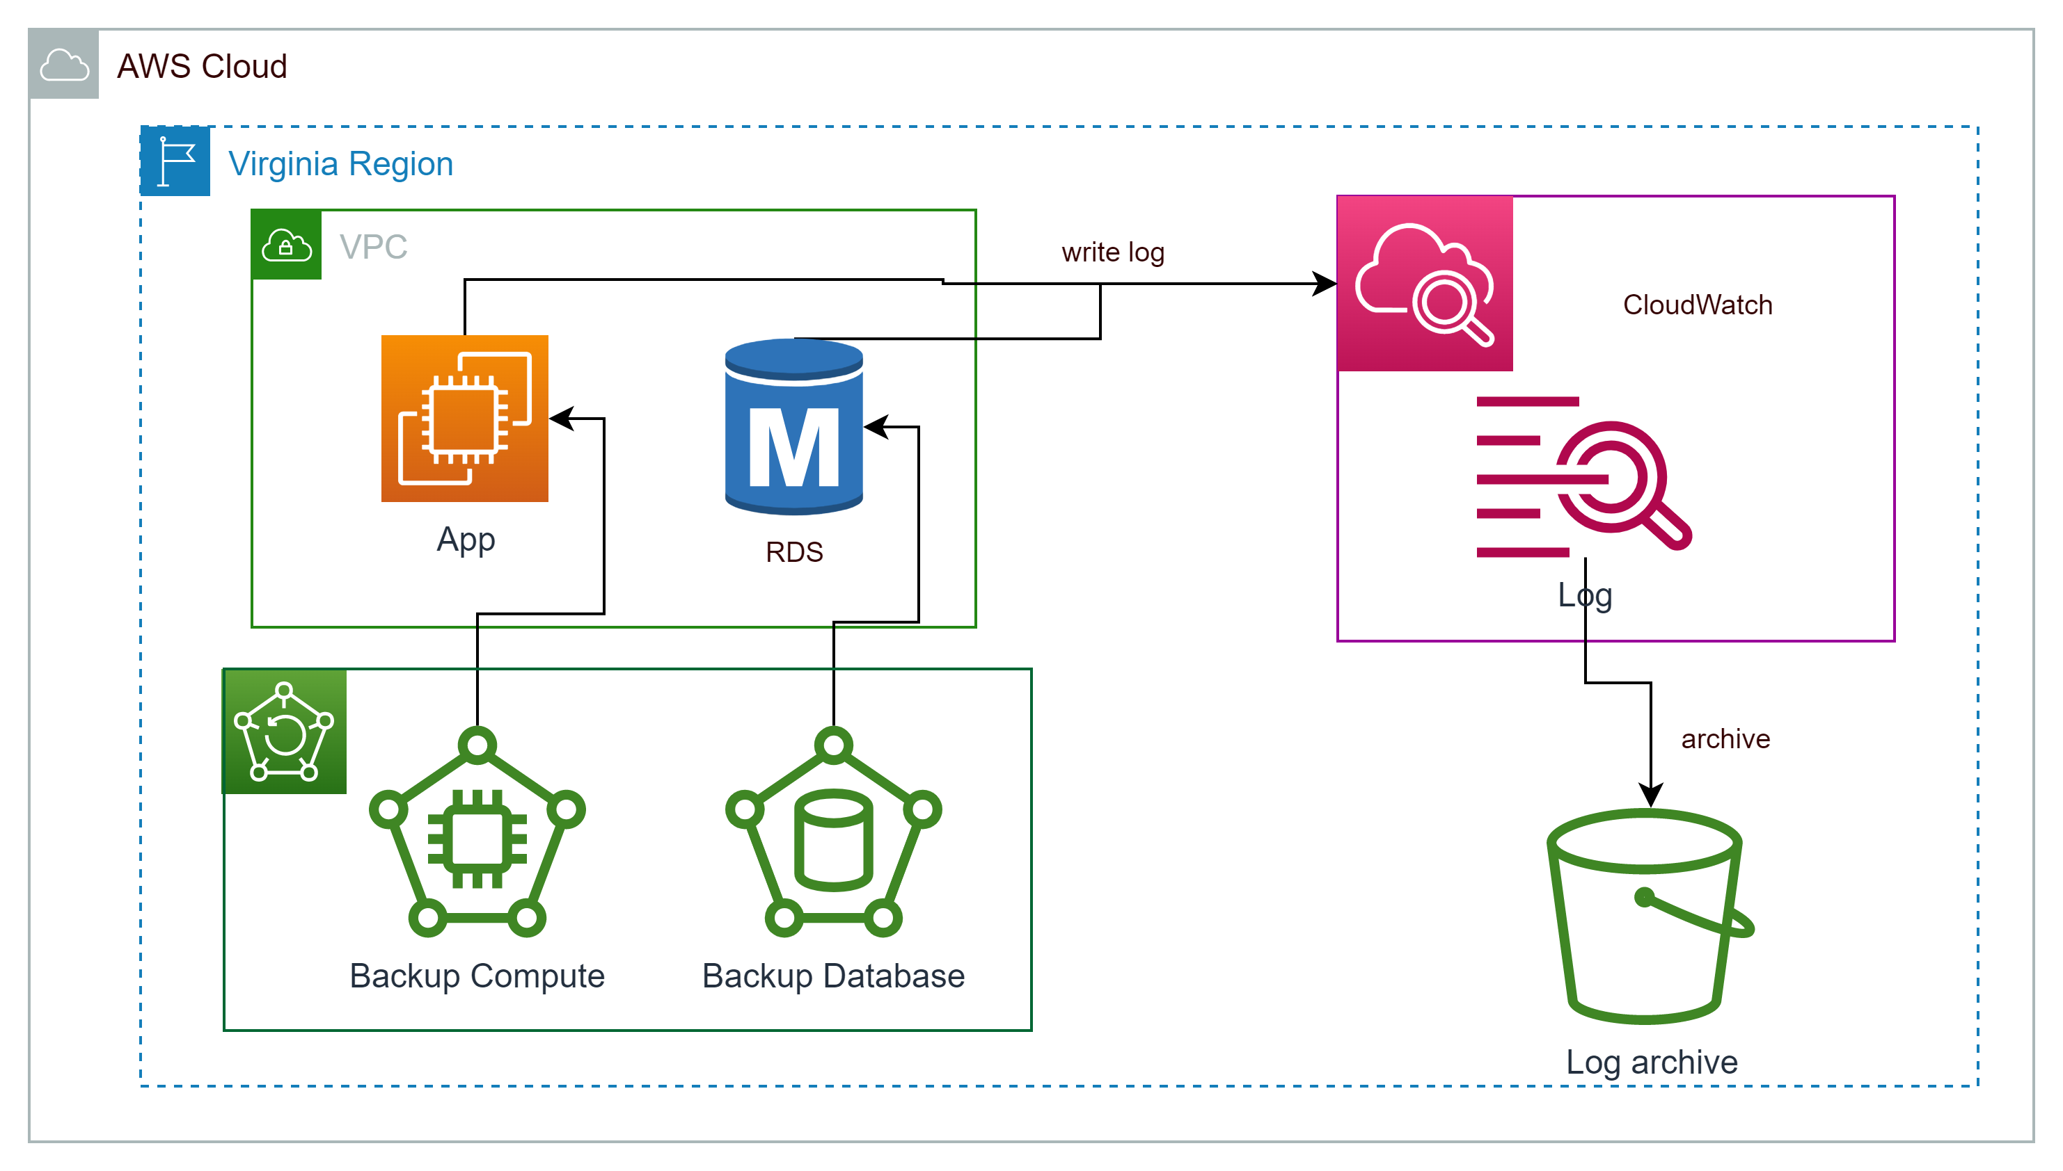

Slide 51
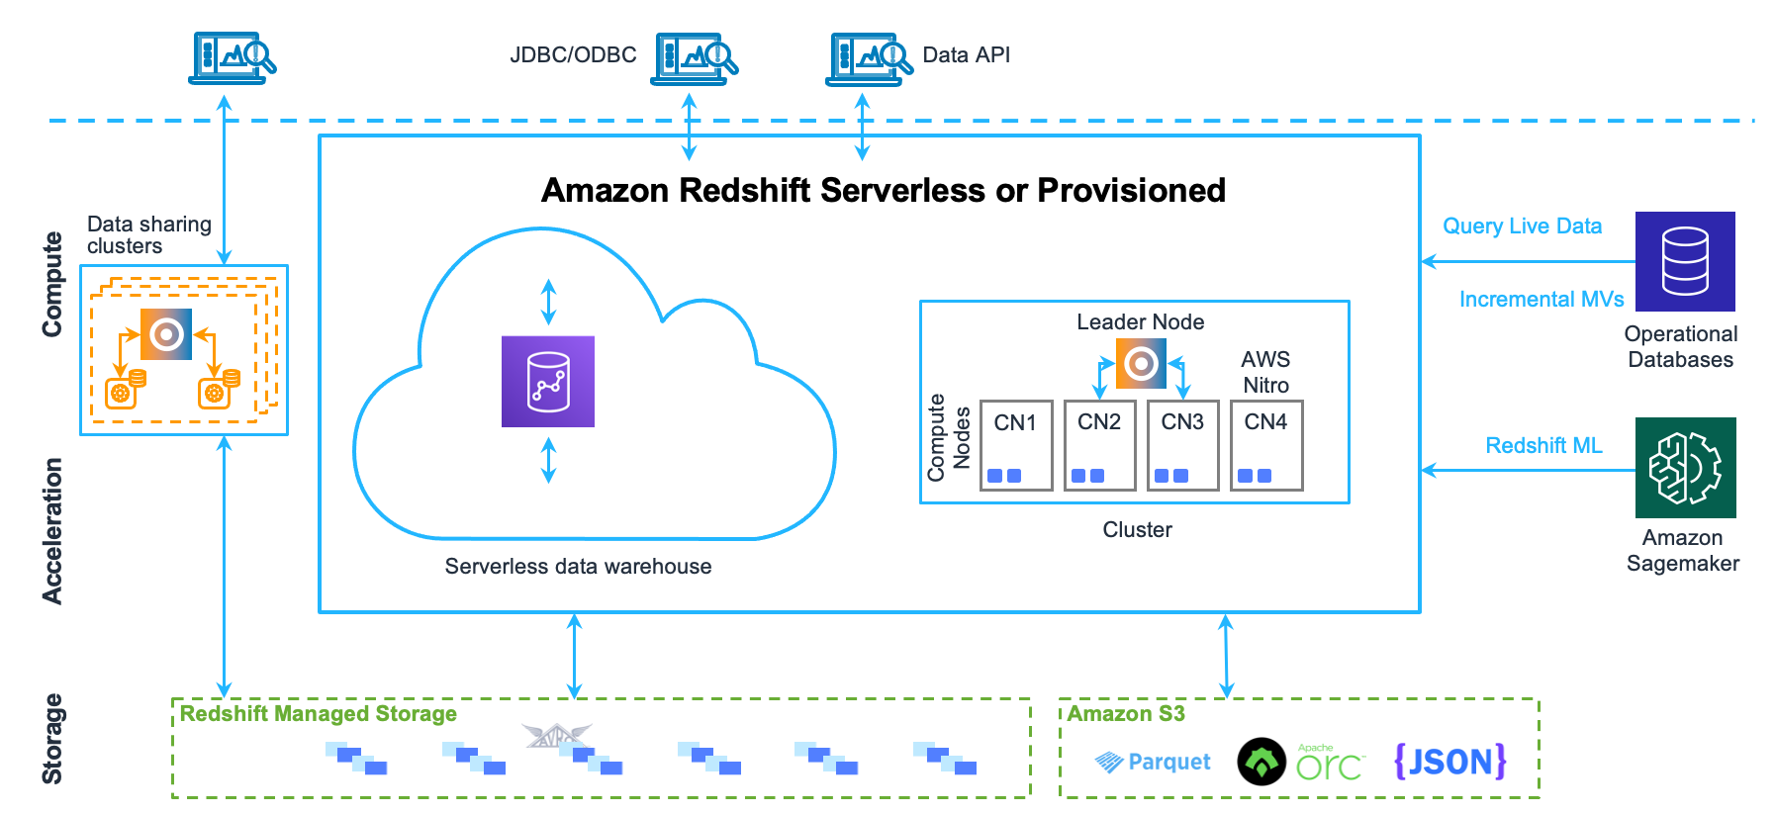

Slide 52
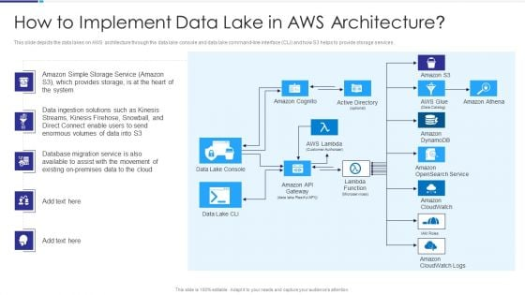

Slide 53
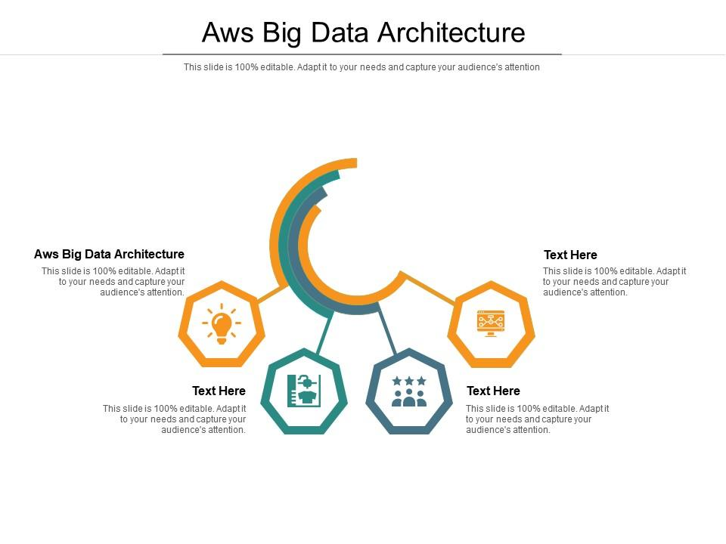

Slide 54
https://www.slidegeeks.com/powerpoint/Aws-Solution-Architecture

